Slide 1
Navigating MMS for New Attendees
Getting the most out of the week of MMS at the Mall of America!

Slide 2
Attention
MMS sessions are 60-75 minutes followed by a LONG Q&A time
Please hold detailed questions until that Q&A starts
Feel free to ask clarification questions during the session
Remind the speakers to use Zoom It when you can’t see
Remind the speakers to repeat questions asked from the audience

Slide 3
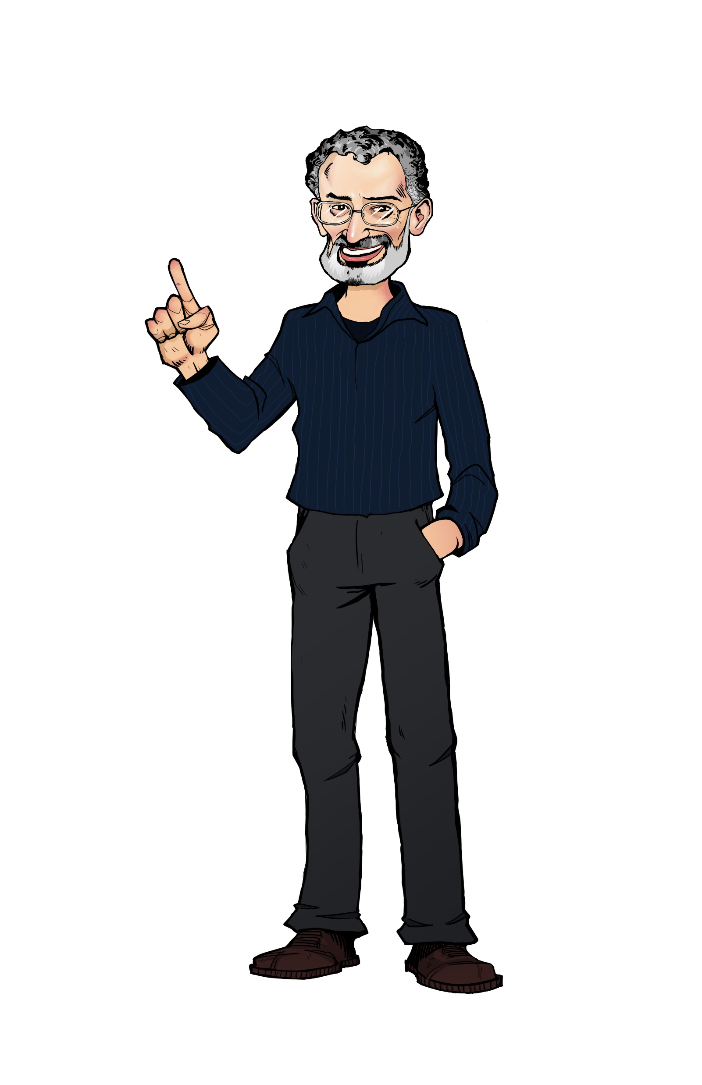

Wally Mead
MMS Staff
wally@mmsmoa.com
@wally_mead

Slide 4
MMS Speakers
The speakers are here for YOU!
You can find them wearing special shirts
They WANT to engage with you
Please feel free to interact with them
Say hi
Ask questions
Have coffee/tea/snacks/lunch/etc
When not on stage, you can usually find them by the escalator and elevators at the big table

Slide 5
Venue Logistics
What you need to know about the venue itself

Slide 6
MMS Location
Mostly on the 2nd floor of the MOA/Radisson Blu location
The Nokomis session rooms are on the 3rd floor by the room elevators
The expo hall is in the sky bridge next to the escalator
Stop by to visit with the vendors and thank them for their participation and sponsorship. They might award you with a prize card for your interaction
Registration is in the foyer outside the Lakes ballrooms
Just past the expo hall over the sky bridge
Expect that all event rooms will be a little chilly from air conditioning
Has always been that way in previous years, so prepare for it (think layers)
Don’t expect power outlets in the session rooms
We want you paying attention to the presentations as well as the Q&A instead of answering emails!

Slide 7
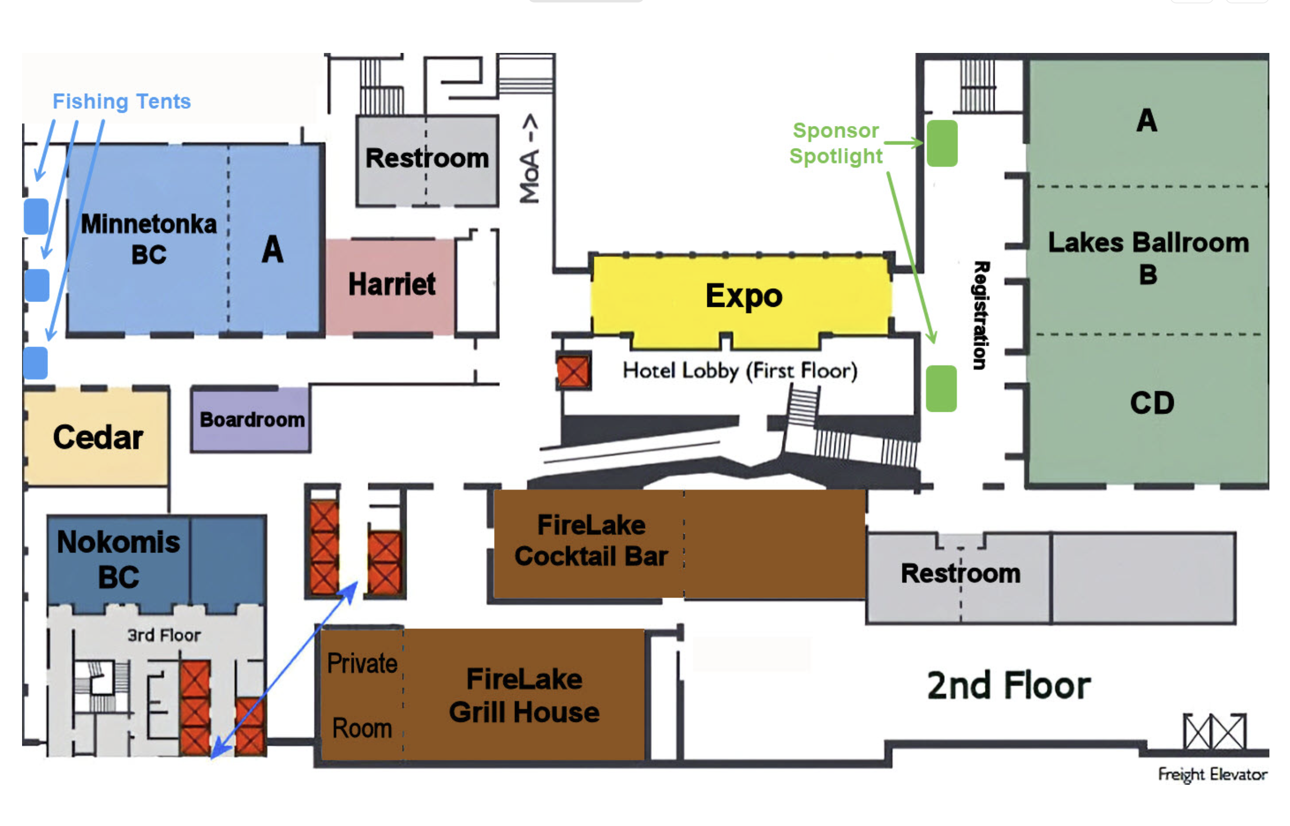
MMS Map

Slide 8
MMS Logistics
What you need to know about the event and navigating it

Slide 9
New This Year
More Happy Hour sessions
With a couple of larger ones that previous years
Drink Coins are now Drink Cards
More on Drink Cards later in this presentation
Special networking games
Escape Rooms
Great Big Game Show
Career connections
Special 20 minute 1:1 time to chat about careers
MMS Newsletter
Optional subscription
Sponsor Spotlights
Special sponsor presentations in the Lakes foyer

Slide 10
MMS Events
The Welcome Reception is Sunday at 5:00pm
Different events, games and food in each of the MMS session rooms
This will help familiarize you with the room locations
This will also help spread out the crowd for easier networking
Can sign up for Fishing Sessions by finding me
Disc golf lessons for beginners are available Sunday as well as Monday through Thursday evenings
At a local course about a mile from the MOA
Some sponsors have parties during the evenings also

Slide 11
MMS Welcome Reception
Different food/activity in each MMS session room
Lakes Foyer – Bar and heavy food
Lakes A – Steve Jesok Band – The Mystery Muffins
Lakes B – TBA
Lakes CD – Head Shots (all day) and food
Harriett – Minnesota tasting stations
Minnetonka Foyer – Bar
Minnetonka A – Big Brothers Big Sisters
Minnetonka BC – Jazz trio and desert lounge/coffee
Cedar – Oversized games
Nokomis – MMS video montage

Slide 12
MMS Sessions
Sessions start each day at 8:00am
Up to eight unique sessions to choose from
We recommend that you attend what you registered for
However, if your session doesn’t meet your needs, feel free to leave and attend another (if there is space available)
Unlike most events you may have attended, our sessions are 1:45 in length
60-75 minutes of presentation/demo time
The remainder is extended Q&A time for you to ask questions, offer suggestions/answers, network with other attendees as well as the experts on stage. Drink cards awarded for great questions
The final session of each day is a Happy Hour session
Use drink cards or purchase your beverage at the bars

Slide 13
MMS Sessions (2)
There may be some lunch sessions each day at 12:00
This is the ‘official’ lunch break, however, since you are on your own for lunch, you can head out to the mall (or elsewhere) whenever you want
Coffee and snacks will be provided in the expo hall each morning and afternoon
The expo hall is open before sessions start each day, and run through the end of sessions each day
Sponsors may also have their own throughout the week
The final sessions end Thursday around 6:30pm
Please submit session feedback once the session has ended
Can only do so if you have registered for that session

Slide 14
Fishing Sessions
There will be Fishing sessions for you to visit with Microsoft or Speakers
These have been extremely popular at previous MMS events
They always result in some features/updates driven into the product as a result of your feedback
You will be able to sign up for 20-minute discussions/chats with either the product group or speakers assigned to specific slots
They will run during normal session times – SHOW UP for what you register for!
Snacks and drinks will be available
Speakers understand that Fishing Sessions run during their session and that you might have to leave for a while and return. They won't be offended!

Slide 15
Fishing Sessions (2)
There will be one Microsoft tent where the product group will focus on the product
Bring your laptop to show your concerns/requests
The two Speaker tents are ‘anything goes’ format – with specific speakers assigned to specific sessions
Can only sign up for one Fishing session initially (find me!)
MMS - Midwest Management Summit - MMS Fishing Sessions

Slide 17
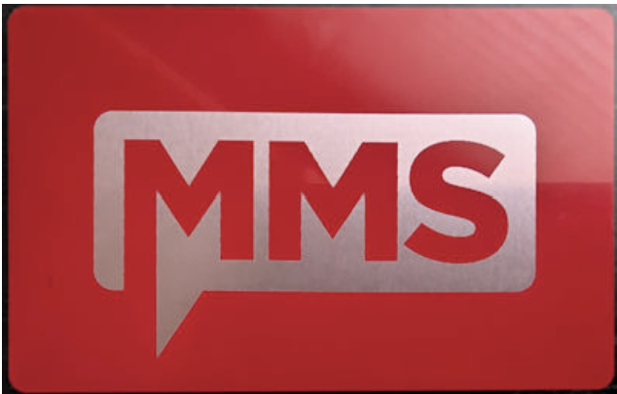
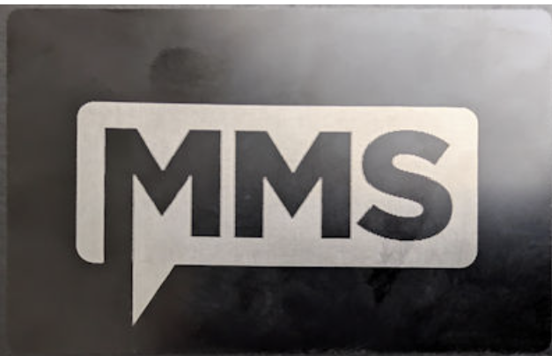

MMS Cards
Earn drink cards by:
Completing registration
Completing your Welcome Reception passport
Asking good questions in sessions
Engaging with speakers
Signing up for a Fishing Session
Doing an interview with Sam
Earn prize cards by talking to sponsors
Exchange for prizes at registration desk
Extra Fishing Sessions, prizes, FireLake cards
Special cards get you into a raffle
Special prizes – MMS pass, phone, earbuds
Can also get entered into the raffle by donating to our event charity – Big Brothers and Big Sisters Twin Cities

Slide 18
MMS Future Dates
Yes, it’s going to happen again, twice a year in different locations

Slide 20
MMS Code of Conduct
MMS Code of Conduct
MMS seeks to create a respectful, friendly, and professional experience for all participants. As such, we do not tolerate harassing or disrespectful behavior, messages, images, or interactions by any event participant, in any form, at any aspect of the program including business and social activities, regardless of location
We encourage everyone to assist in creating a welcoming and safe environment. Please report any concerns, harassing behavior, suspicious or disruptive activity to the nearest security guard or event staff. MMS reserves the right to refuse admittance to, or remove any person from, MMS at any time in its sole discretion

